Slide 1

The Blueprint for Smarter Advertising
Driving Cost Efficiency in Digital Advertising
Prepared by:
Jiahong, Zhuo

Slide 2
Table of Chapters
Chapter 1: Overview & Problem Statement
Chapter 2: Data Sources & Methodology
Chapter 3: Data Analysis & Insights
Chapter 4: Predictive Modeling & Interactive Demo
Chapter 5: Model Assumptions & Limitations
Chapter 6: Recommendations & Next Steps

Slide 3
Chapter 1: Overview & Problem Statement

Slide 4


Audience
Annie Chen, Senior Marketing
Manager, Apple Inc.
John, Data Analytics Manager,
D Advertising Pte Ltd

Slide 5
Problem Statement
Apple is spending heavily in digital advertising for its products
Want to increase its cost efficiency for digital advertising budget

Slide 6
Do you know the difference?
Increasing Cost Efficiency
Minimizing Cost

Slide 7
Goals
Achieve at least 10% increase in expected online purchase of Apple products
Achieve 20% decrease in cost per acquisition/purchase (CPA)
Assume advertising budget unchanged

Slide 8
Chapter 2: Data Sources & Methodology

Slide 9
Data Source
Fictitious digital advertising Kaggle dataset (May - Aug 2025)
Ad campaigns spend & event types from social media platforms, no revenue data
Cleaned & removed duplicate records (approx. 1%)
Created metrics: CPA, Conversion Rate (CR), Click-Through Rate (CTR)

Slide 10
Methodology
Exploratory Data Analysis to identify trends, inefficiencies & outliers
Predictive Modeling (Comparing Logistic Regression vs Light GBM) to predict purchase/conversion probabilities
Tableau Visualization for Dashboard

Slide 11
Chapter 3: Data Analysis & Insights

Slide 12
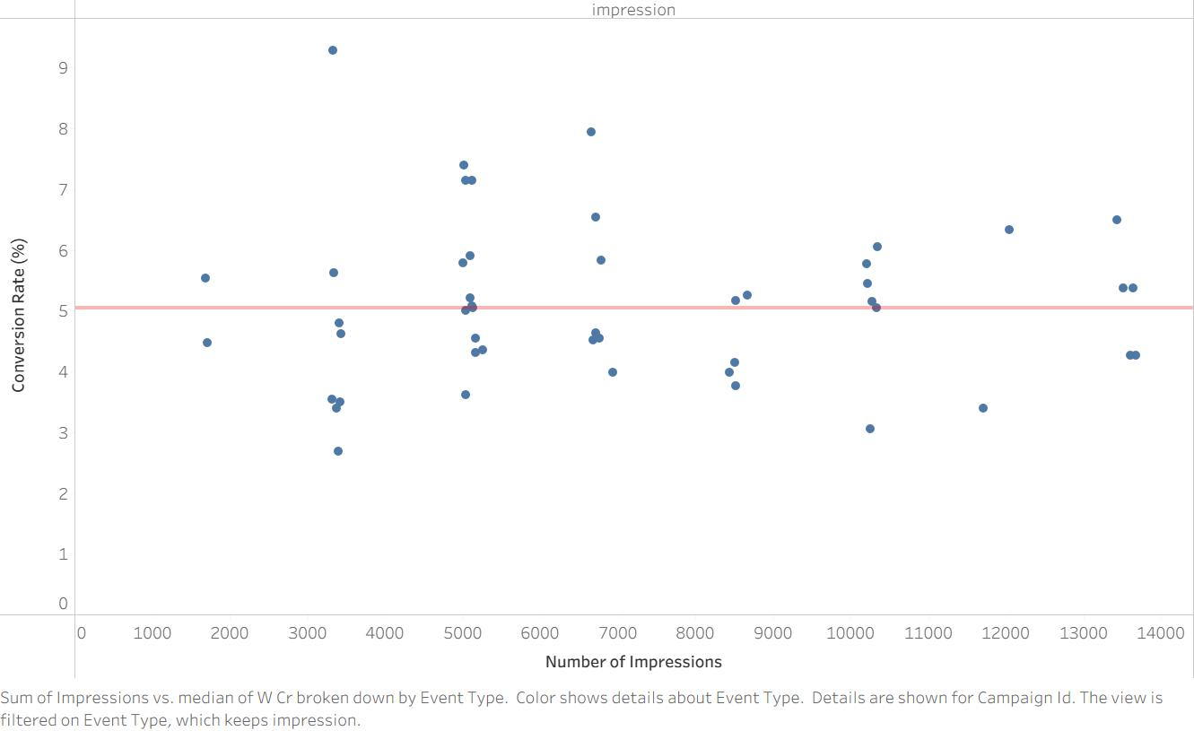
Analysis: Conversion Rate & Ad Impressions
Stable Ad Conversion Rate (3-6%) at all levels of impressions
Ad scaling is ineffective as conversion rate doesn’t increase with impressions
Apple should increase cost efficiency at current budget, instead of increase ad budget

Slide 13
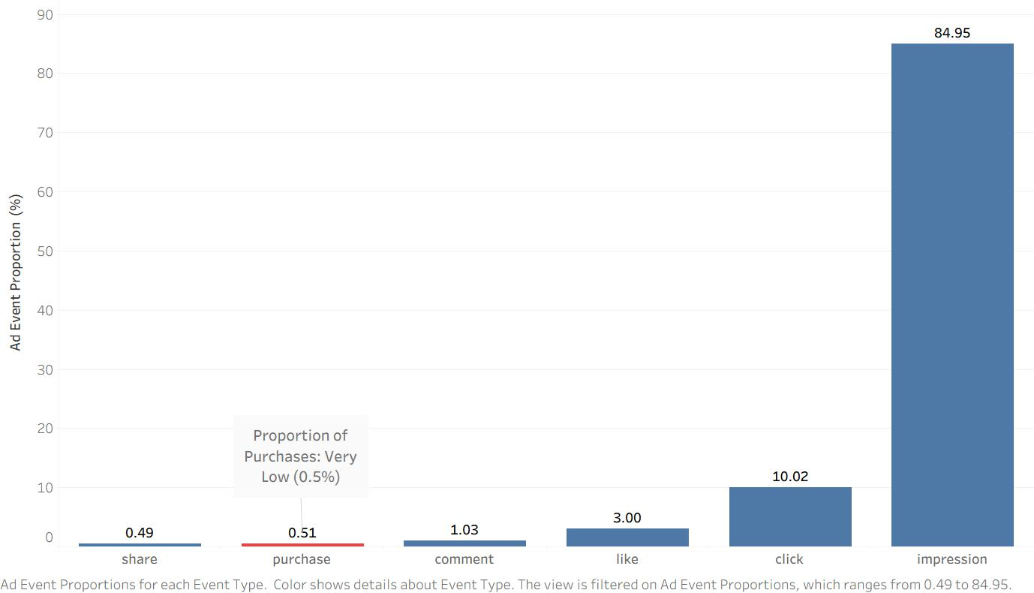
Analysis: Low Purchase Rate
Very low purchase rate (0.5%) as compared to industry of 2-4%
Affect prediction modeling performance results
In-depth research to find out cause & increase it

Slide 14
Analysis: Target vs Actual Users’ Age Group Segments
High actual-target user age group mismatch at 78%
Ineffective Age Group Targeting
Improve on user data validation process to reduce mismatch

Slide 15
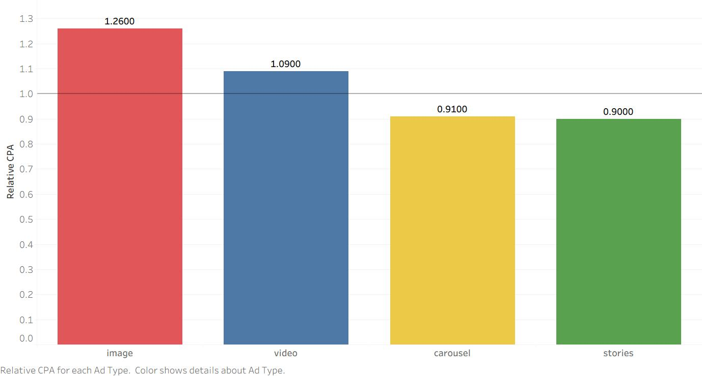
Analysis: Relative CPA & Advertisement Type
Image & Video have higher relative CPA compared to Carousel & Stories
Ad Type Median CPA = 1
Re-allocate budget from Image & Video to Carousel & Stories
Cost Efficiency

Slide 16
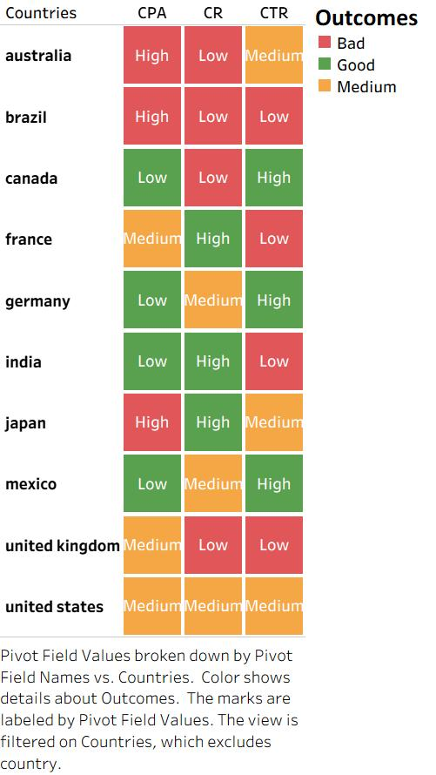
Analysis: Countries & CTR, CR & CPA
High Cost, Low Purchase Countries: Australia, Brazil
Low Cost, High Purchase Countries: India
High Cost, High Purchase Country: Japan
Reduce allocation to Australia, Brazil, increase exposure to India

Slide 17
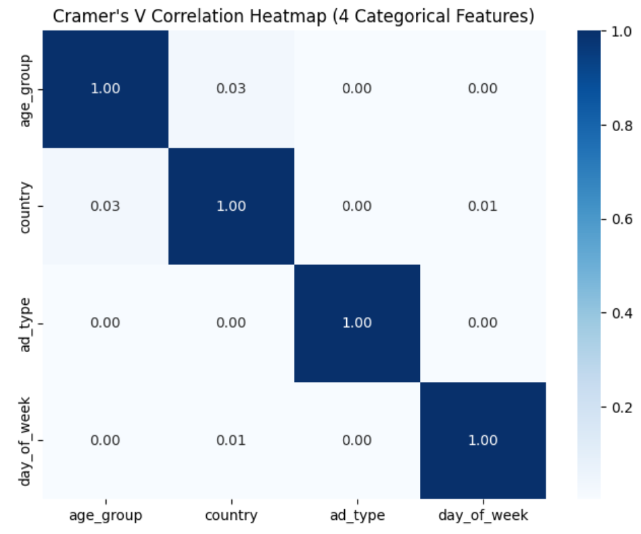
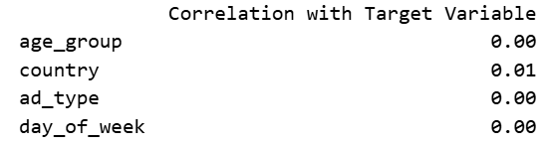
Correlation Analysis
Very low correlations among features, & with Purchase Rate (Target Variable)
Due to low purchase rate (0.5%)
No Multicollinearity issue

Slide 18
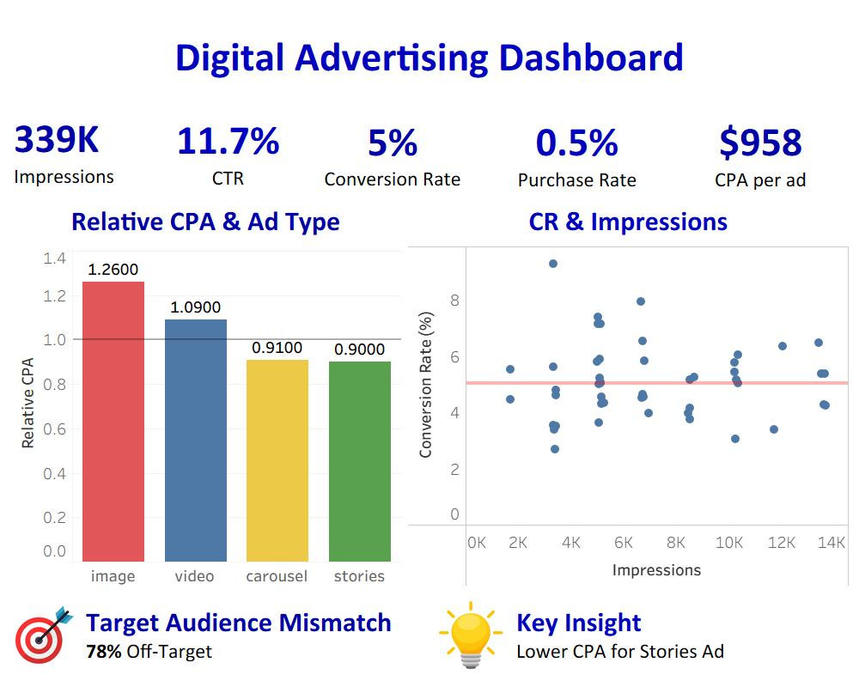
Summary

Slide 19
Chapter 4: Predictive Modeling & Demo

Slide 20
Comparison of 2 Predictive Models
 | Logistic Regression (Log R) | Light GBM (LG) | Winner
Ease of Interpretation | Very Easy (Coefficients shows features’ impact) | Difficult (features’ importance is indirect) | Log R
Speed | Fast to train | Fast to train (requires hyperparameters tuning) | Tie
Data Suitability | Small to Medium Datasets (<1m observations) | Large Datasets (> 1m observations) | Log R
Performance | Mid Precision (0.5) Mid Recall (0.53) Mid F1 Score (0.33) | Low Precision (0.01) High Recall (0.96) Low F1 Score (0.01) | Log R due to more balanced, lesser budget wastage (false positives)
Predictive Model Chosen: Logistic Regression

Slide 21
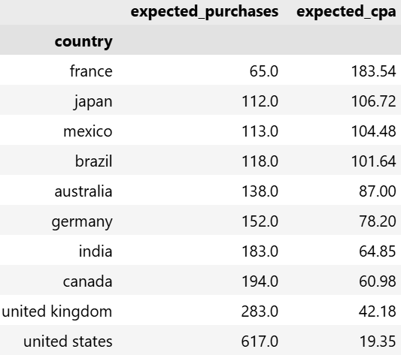
Predicted Results by Countries
Countries & CPA have strongest impact on Purchase Probability
Lowest Purchase & Highest CPA: France & Japan
Highest Purchase & Lowest CPA: United States & United Kingdom

Slide 22
Demo on Predicting Cost of Acquisition (CPA) CPA Prediction

Slide 23
Chapter 5: Model Assumptions & Limitations

Slide 24
Assumptions
Online users’ behavior patterns are representative of real world
Market conditions remain unchanged
Purchase variable is linearly related to features
Features are independent of each other

Slide 25
Limitations
Low purchase rate (0.5%) model accuracy, predictions less reliable
4-month time period restricts visibility of seasonal or long-term digital ad trends
Absence of ad revenue data restricts digital advertising analysis
High mismatch of actual-target group segment hinders age group segment analysis

Slide 26
Chapter 6: Recommendations & Next Steps

Slide 27
Business Recommendations
Re-allocate 20% digital ad spend from Image to Carousel & Stories ad types, result in 18% in expected number of purchases
Re-allocate their digital ad budget from high CPA cost countries (France) to low-cost countries (United States & India). CPA expected to more than 50%

Slide 28
Data & Model Improvements
Ad revenue data should be included for comprehensive analysis
Longer period data for seasonal trend analysis
User target group data validation process should be improved
In-depth tuning of Light GBM hyper-parameters

Slide 29
Next Steps
20% of digital ad budget re-allocated from Video to Stories ads
Pilot ad reallocation from France to US/India to test for 1 month
User Target data validation process to be improved

